Slide 1


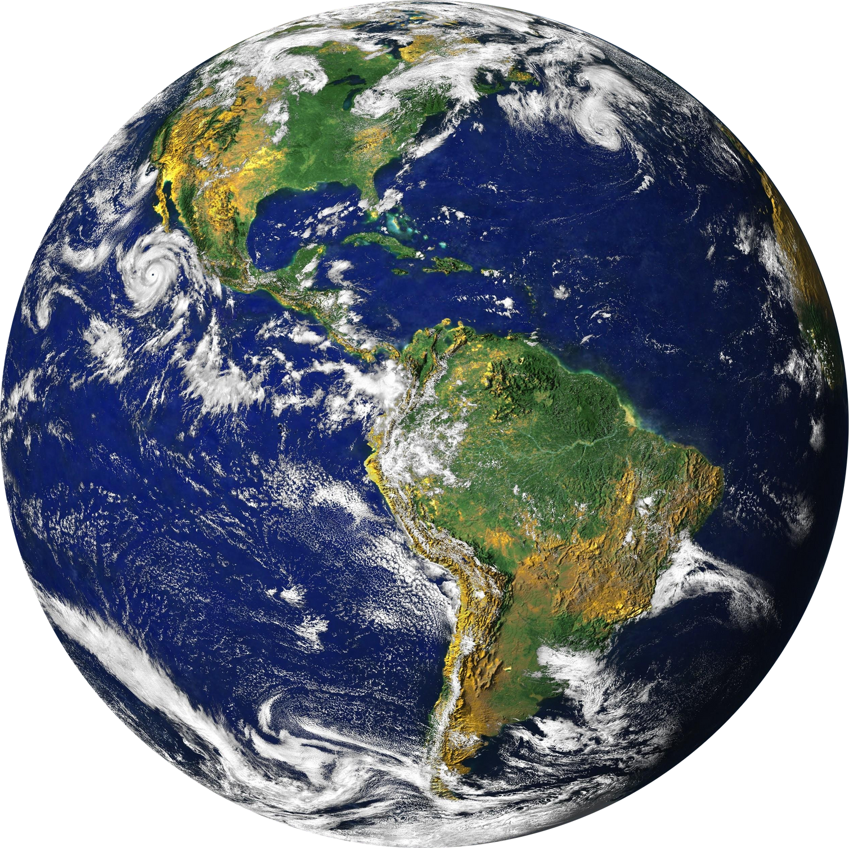
Infosys Springboard Internship Program
ENVIROSCAN
AI-POWERED POLLUTION SOURCE IDENTIFIER USING GEOSPATIAL ANALYTICS
Praveen S
Department of CSE (AI & ML)
K.S.Rangasamy College of Technology

Slide 2
PROBLEM STATEMENT
Existing pollution monitoring systems mainly report pollutant concentrations without identifying their sources, which limits effective and targeted environmental action. There is a need for a system that can automatically identify and classify pollution sources using real-time data. This project addresses the gap by using machine learning, weather data, and geospatial analytics to predict pollution sources, visualize high-risk zones, and support data-driven decision-making for urban planning and environmental management.
OBJECTIVES
Develop an ML model to automatically classify pollution sources
Create a real-time dashboard for pollution monitoring
Integrate geospatial features for context-aware predictions
Provide actionable alerts and recommendations

Slide 3
INTRODUCTION
EnviroScan is an AI-powered real-time air quality monitoring and pollution source identification system developed for Indian cities. The project leverages machine learning to classify pollution sources into five categories: Vehicular, Industrial, Agricultural, Burning, and Natural with 92.26% accuracy.
DATA SOURCES & APIS
OpenAQ API v3: Real-time air quality data (~978,000 records)
OpenStreetMap (Overpass API): Geospatial features
Nominatim API: Geocoding and reverse geocoding
Open-Meteo API: Weather data (temperature, humidity, wind)
Coverage: 32 states/UTs, 165+ districts across India

Slide 4
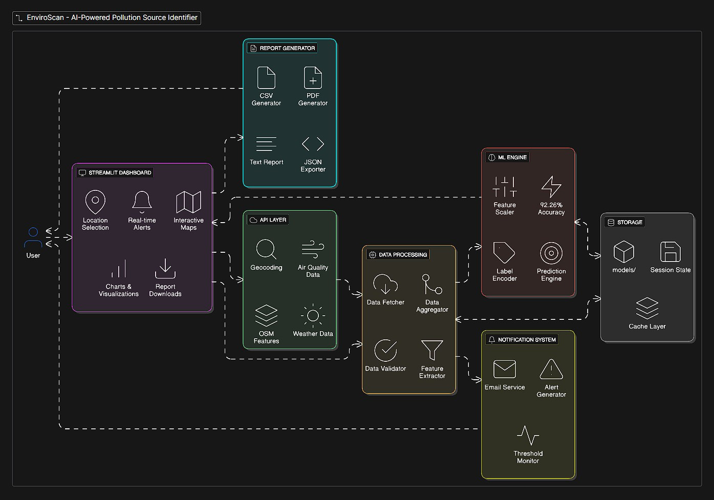
SYSTEM ARCHITECTURE
The system follows a layered architecture with clear separation of concerns:
User Interface Layer: Streamlit dashboard with responsive design
API Integration Layer: OpenAQ, Nominatim, Overpass, Open-Meteo APIs
Data Processing Layer: Fetching, aggregation, validation, feature extraction
ML Prediction Engine: XGBoost model with scaler and label encoder
Output Layer: Alerts, reports, visualizations, email notifications

Slide 5
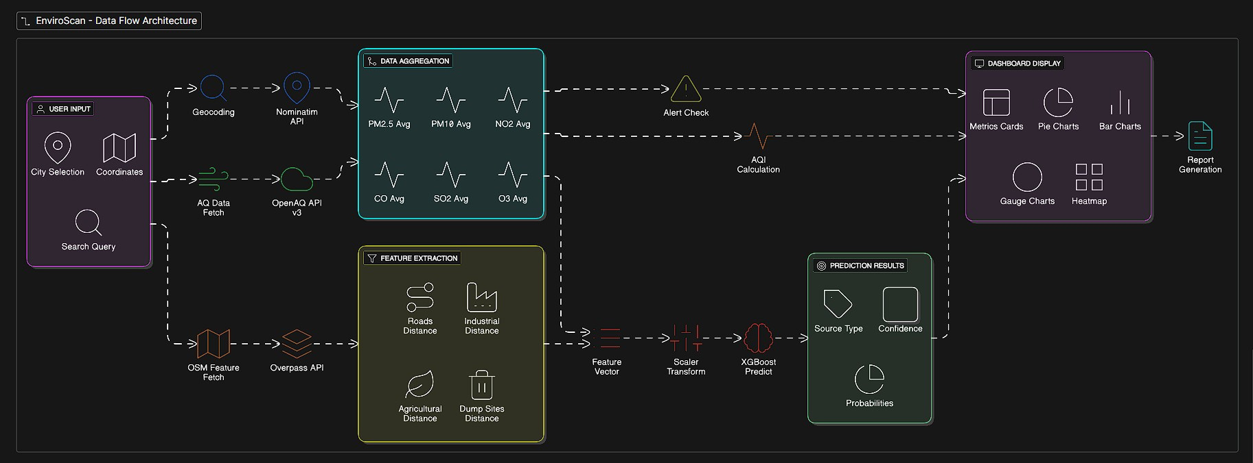
DATA FLOW DIAGRAM
1. User inputs location (city/coordinates/search)
2. Geocoding converts to lat/lon coordinates
3. Parallel API calls to OpenAQ, OSM, and weather services
4. Data aggregation and feature vector creation
5. Standard scaling of features
6. XGBoost prediction with probability distribution
7. Dashboard display with alerts and visualizations

Slide 6
METHODOLOGY OVERVIEW
• Data Collection: Gather pollution, geospatial, and weather data
• Data Preprocessing: Clean, handle missing values, remove outliers
• Feature Engineering: Create 13-dimensional feature vector
• Model Training: XGBoost with SMOTE for class balancing
• Evaluation: 5-fold cross-validation, accuracy metrics
• Deployment: Streamlit dashboard with real-time predictions
POLLUTION SOURCE CATEGORIES
Vehicular: Traffic emissions (high NO2, near roads)
Industrial: Factory emissions (high SO2, near industries)
Agricultural: Crop burning/dust (high PM, near farmland)
Burning: Waste burning (high CO, near dump sites)
Natural: Dust storms/pollen (high PM10/PM2.5 ratio)

Slide 7
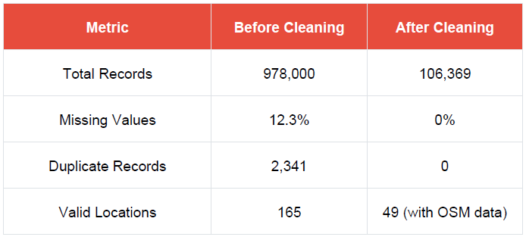
DATA PREPROCESSING AND CLEANING
Step 1: Remove Duplicates : Removed duplicate records based on location_id and timestamp.
Step 2: Handle Missing Values : Applied forward fill for pollutants (<10% missing), filled distance columns with 9999m (no feature nearby), and filled area/count columns with 0.
Step 3: Outlier Treatment : Clipped extreme outliers (>99.9 percentile) and weather data to realistic ranges (temperature: -10°C to 50°C, humidity: 0-100%).
Step 4: Data Type Conversion : Converted datetime columns and ensured numeric types for coordinates.
DATA QUALITY SUMMARY :

Slide 8
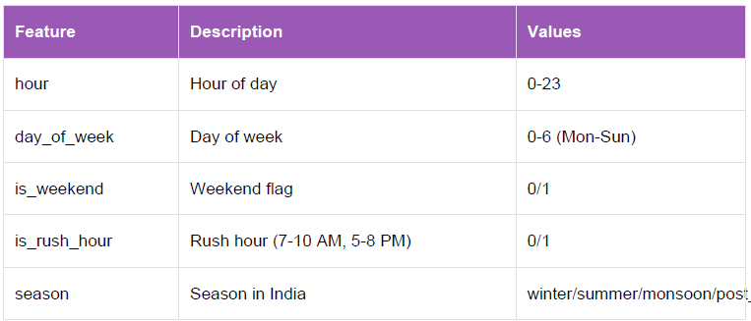
FEATURE ENGINEERING
TEMPORAL FEATURES :
SOURCE LABELING SCORING
Vehicular: Near roads, high road density, high NO₂, rush hours.
Industrial: Near industries, large industrial area, high SO₂.
Agricultural: Near farmland, high PM10/PM2.5, post-monsoon or winter.
Burning: Near dump sites, high CO, evening or night time.
Natural: High dust ratio, low gases, strong wind, no human sources.

Slide 9
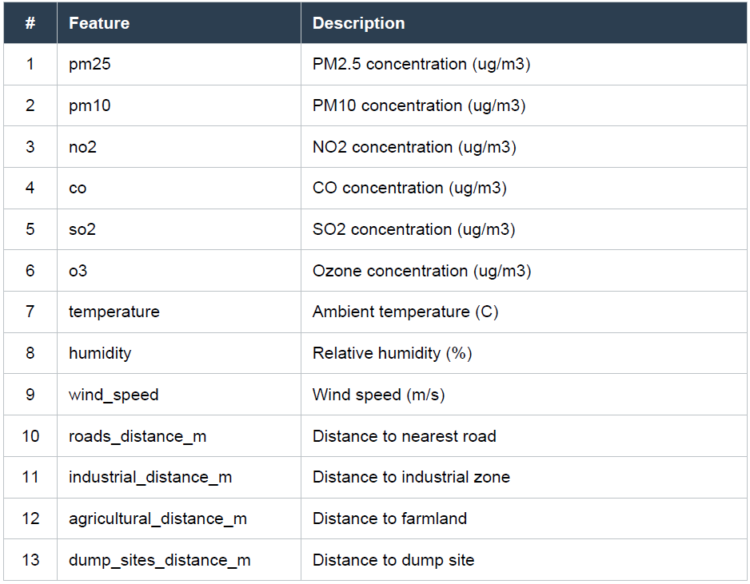
FINAL FEATURE SET (13 FEATURES)

Slide 10
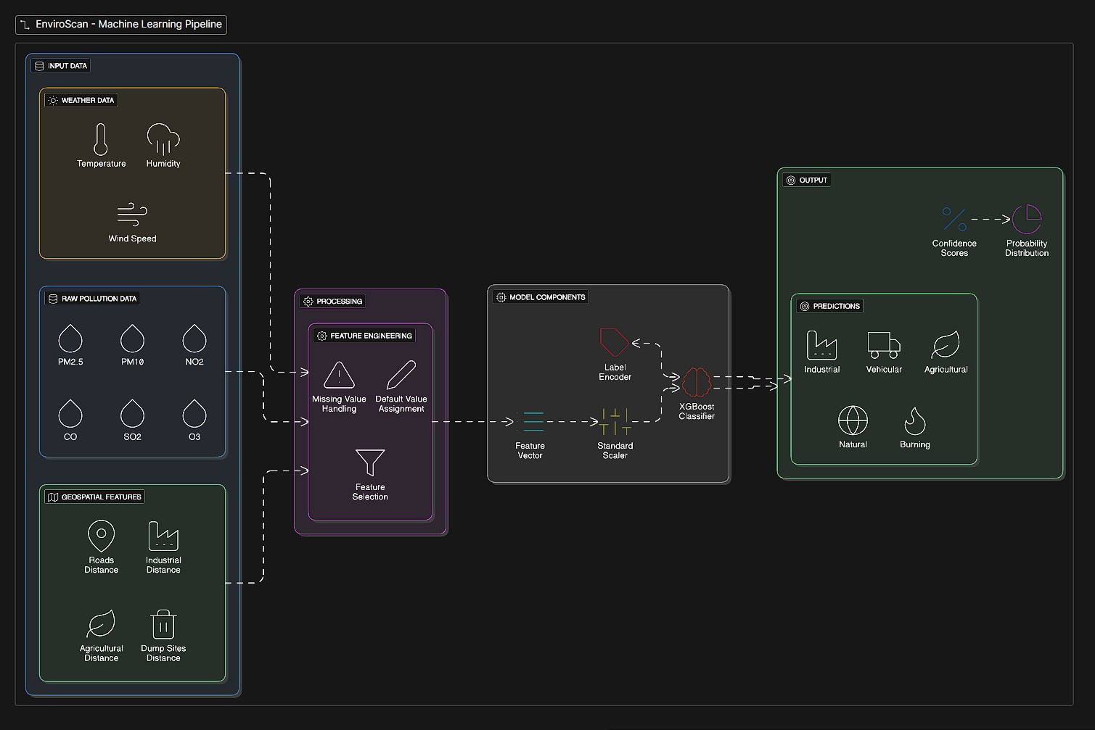
ML PIPELINE
Data Collection & Enrichment: Collected pollution data and added nearby geospatial context to improve source identification.
Data Preprocessing: Cleaned and standardized raw data to ensure quality and consistency for modeling.
Feature Engineering & Balancing: Created meaningful features and balanced classes to improve model learning.
Model Training & Optimization: Trained and tuned the XGBoost model to achieve accurate predictions.
Evaluation & Deployment: Validated model performance and deployed it for real-time pollution source prediction.

Slide 11
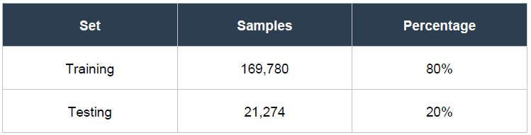
MODEL TRAINING AND TUNING
DATA SPLIT STRATEGY
CLASS IMBALANCE HANDLING WITH SMOTE
SMOTE: Used to balance minority classes by creating synthetic samples only in the training set, preventing data leakage and keeping test data realistic.
Cross-Validation: Applied stratified 5-fold cross-validation to maintain class balance and ensure reliable performance evaluation.
Hyperparameter Tuning: Used RandomizedSearchCV with limited iterations to efficiently find near-optimal model parameters.

Slide 12
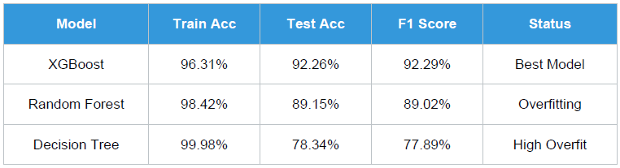
MODEL COMPARISON
XGBoost: Shows best generalization with a very small train–test accuracy gap, indicating strong learning without overfitting.
Random Forest: Displays moderate overfitting, as high training accuracy drops noticeably on test data.
Decision Tree: Suffers from severe overfitting, performing extremely well on training data but poorly on unseen data.
Overall, XGBoost is the optimal model due to its strong generalization and built-in regularization.

Slide 13
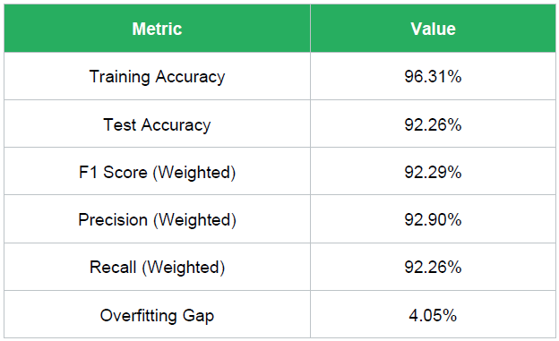
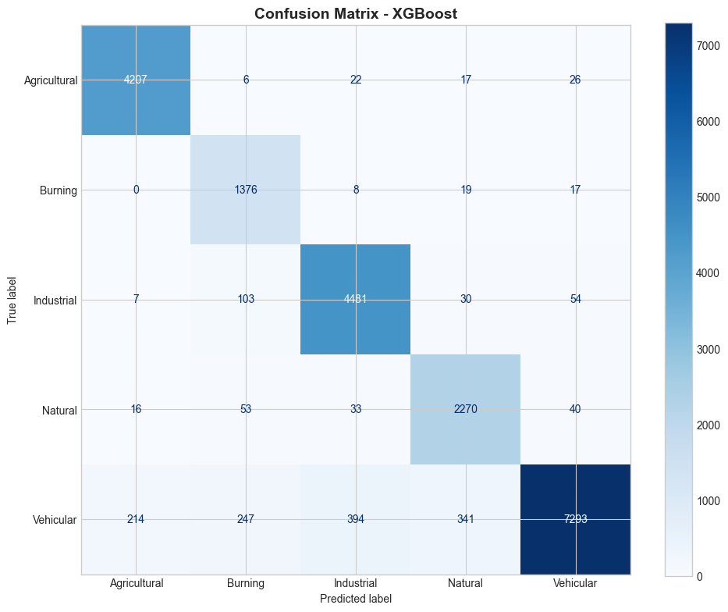
EVALUATION METRICS AND RESULTS
OVERALL PERFORMANCE
CONFUSION MATRIX ANALYSIS
The confusion matrix shows how well the model predicts each pollution source by comparing actual and predicted classes. Correct predictions appear on the diagonal, while errors show where classes are confused.

Slide 14
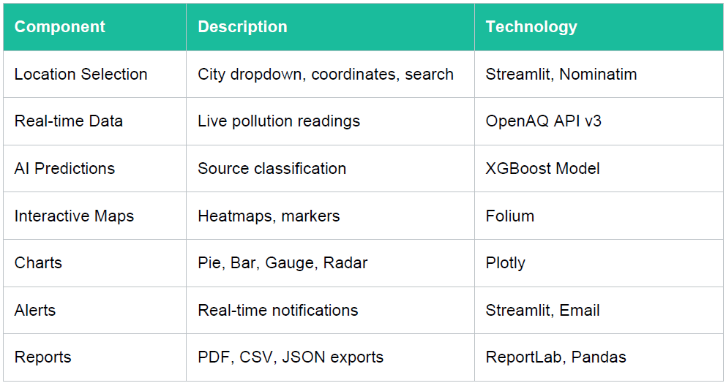
DASHBOARD FEATURES
DASHBOARD COMPONENTS

Slide 15
CONCLUSION
The EnviroScan project successfully demonstrates the practical application of machine learning and geospatial analytics for environmental monitoring. The system provides an end-to-end solution for air quality analysis and pollution source identification, from data collection to actionable insights delivery.
KEY ACHIEVEMENTS
Data Collection & Automation: Built an automated data pipeline covering 165+ Indian districts.
Model Performance: Achieved 92.26% accuracy using an XGBoost classifier.
Visualization & UI: Created an interactive Streamlit dashboard for real-time monitoring.
Geospatial Intelligence: Integrated OpenStreetMap features to enhance prediction accuracy.
Alert Mechanism: Implemented an email alert system for critical pollution levels.
Reporting & Export: Developed automated PDF report generation capability.

Slide 16
THANK YOU

